Slide 1

OOP
Object Oriented Programming
Lecture 15
Lecture 1

Slide 2
Inheritance

Slide 3
Inheritance?
When properties and member functions of base class are passed on to the derived class.

Slide 4
Constructor without parameters
Passing data members

Slide 5
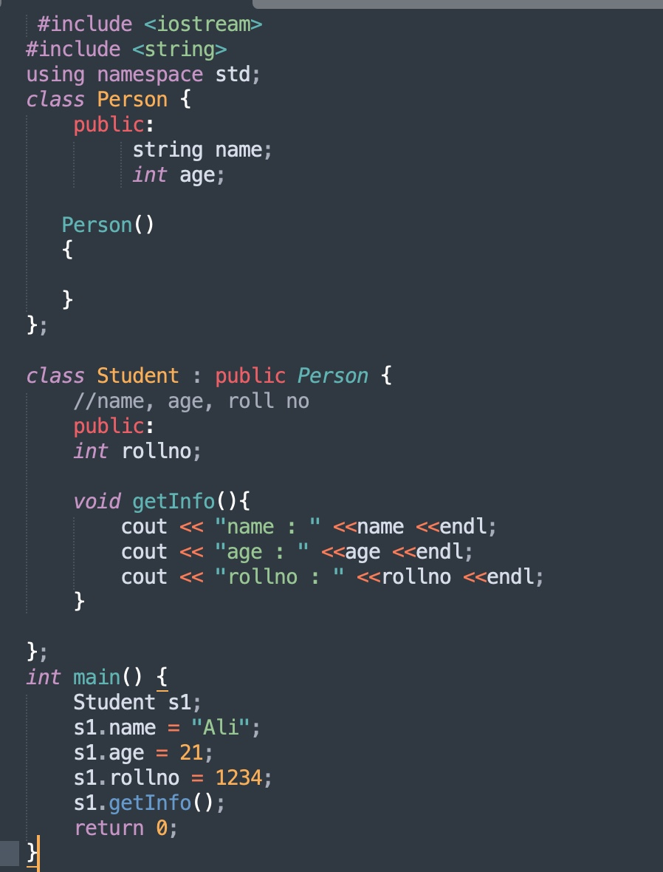
Notes:
Task 1 contains the code of this

Slide 6
How constructor is called?
First Base Class then drived class

Slide 7
How destructor is called?
First drived class then base class

Slide 8
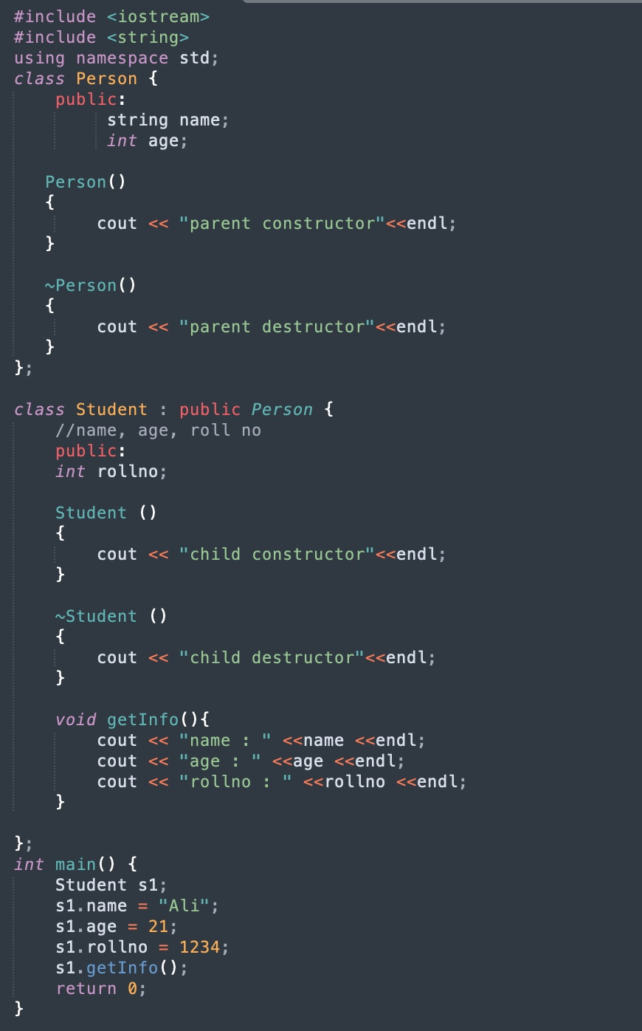
Notes:
Task 2 contains the code of this

Slide 9
Constructor with parameters

Slide 10
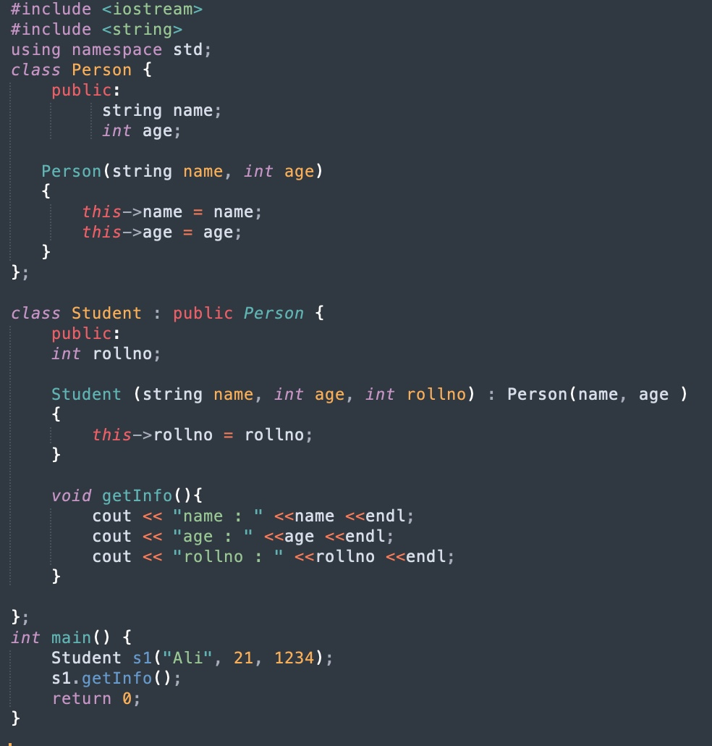
Notes:
Task 3 contains the code of this

Slide 11
Constructor without parameters
Passing member functions

Slide 12
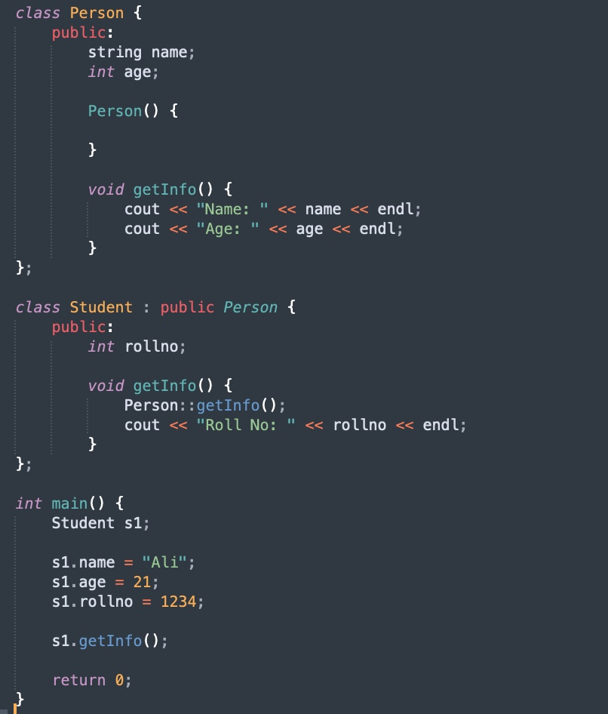

Slide 13
Creating object of base/parent class

Slide 14
Consider the code from the next slide and write its output?

Slide 15
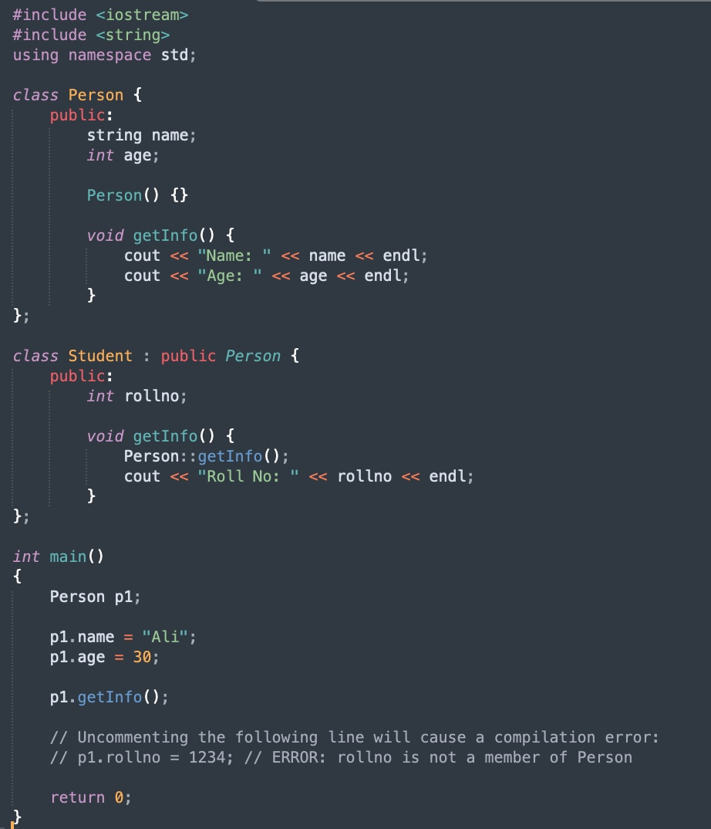

Slide 16
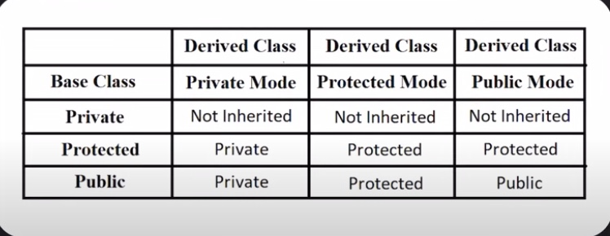
Mode of Inheritance

Slide 17
Code with private Access Specifier

Slide 18
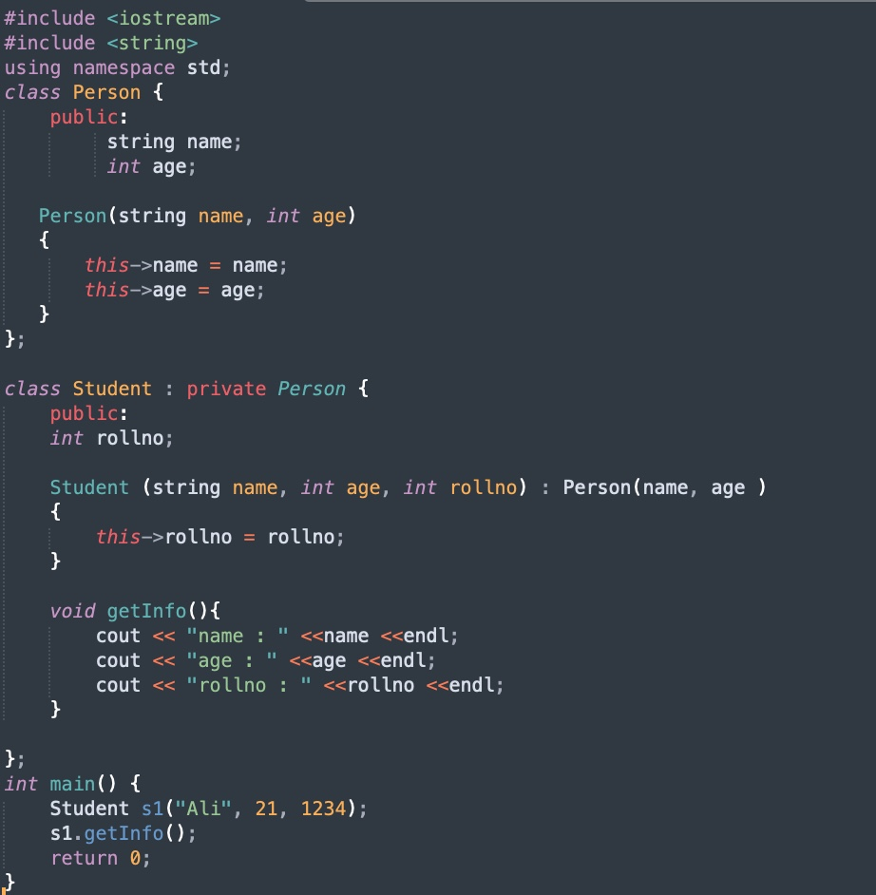
Notes:
Task 4 contains the code of this

Slide 19
Code with protected Access Specifier

Slide 20
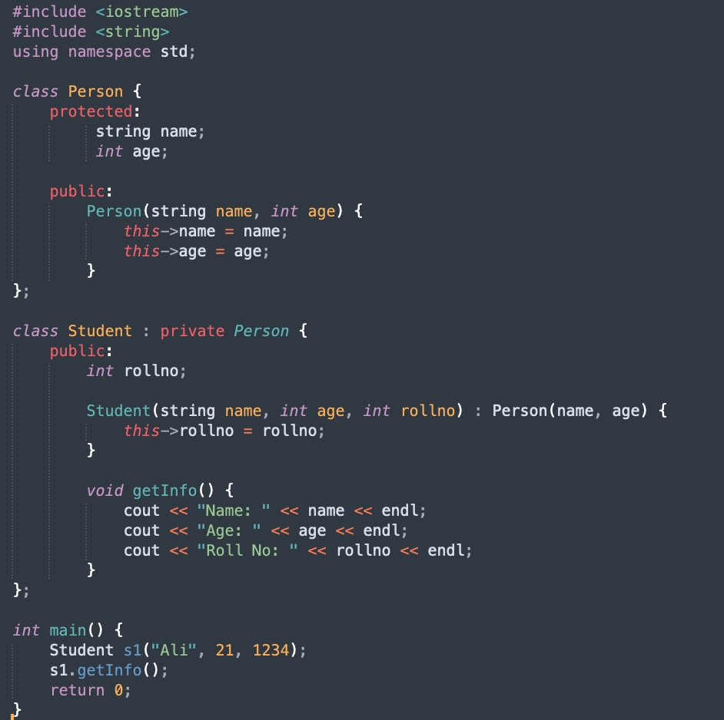

Slide 21
Practise Questions - Question 1
Scenario:
You have a Car class as the base class and a SportsCar class as the derived class. Both classes have a speed member variable, but in the derived class, it’s marked private. You are asked to demonstrate how the different access levels affect member access.
Task:
Create a base class Car with a public member speed and a function showSpeed().
Create a derived class SportsCar that has a private speed member but overrides the showSpeed() function to access the speed member.
Show what happens when trying to access the speed member using objects of Car and SportsCar.

Slide 22
Practise Questions - Question 2
Scenario:
You have a Vehicle class with a protected member fuelLevel, which is inherited by Car. You need to access the protected member from within the derived class and explain what happens when trying to access it using an object of the base class.
Task:
Create a base class Vehicle with a protected member fuelLevel.
Create a derived class Car that has a member function to access and display fuelLevel.
Show what happens when trying to access fuelLevel from an object of Vehicle.

Slide 23
Show me the working of these practise questions

Slide 24
End of Lecture

